Slide 1
Mottled Stars - Results
How Does Starspot Coverage Affect Stellar Brightness Variability?
Miles L. Johnson, Gregory A. Feiden

Slide 2
Mottled Stars
The Mottled Stars project aims to advance our theoretical understanding of star spots and their effects on their host stars
Our goal was to model a spotted star to investigate how spots affect brightness over time
We planned to do this by:
Creating 3D Stellar Models
Peppering them with starspots
Projecting the stellar surface onto a 2D plane
Plotting the brightness of the visible hemisphere against rotational degree

Slide 3
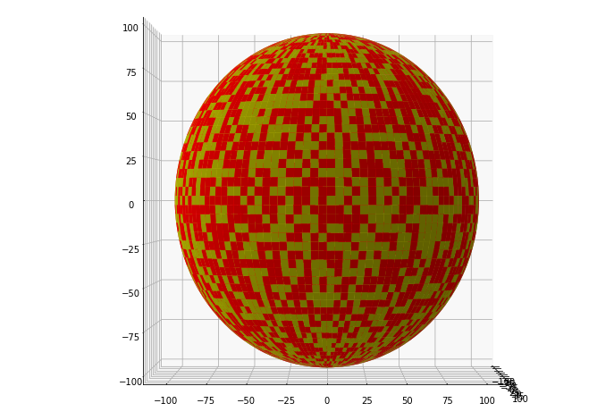
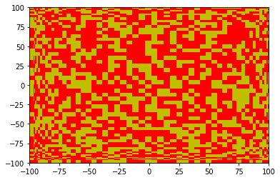
Two-Dimensional Projection
Our stellar model was divided into many small cells
Code was written that randomly selected cells to be ‘spot’ cells
We chose a projection that would conserve the apparent surface area of the cells

Slide 4
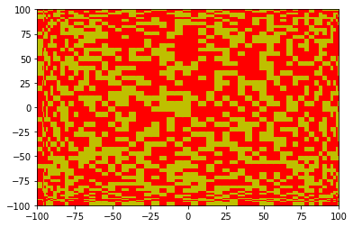
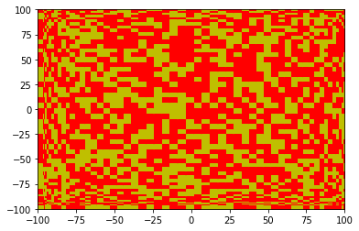

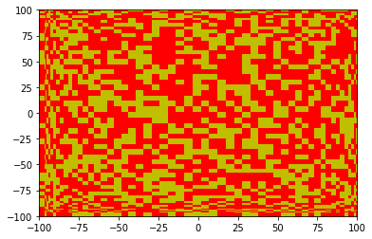

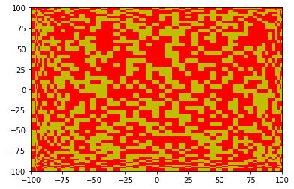
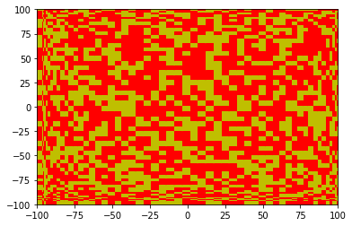

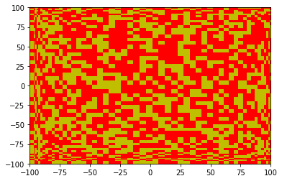
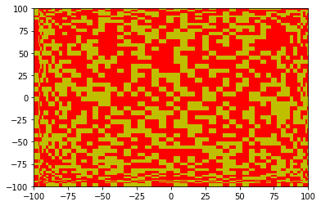
2D Projection of Rotation
We successfully coded our two-dimensional projection to rotate
This was a massive step towards integrating luminosity over time

